Slide 1
Module 1 Data Warehouse Concepts and Architectures
Lesson 2: Course topics and assignments
Notes:
Welcome to Data Warehouse Essentials for Aspiring Business Intelligence Professionals
Four course sequence on data warehouse essentials along with a capstone project course
Second course in the track on data warehouse essentials covering concepts, design, and data integration, fundamental elements of data warehouses.
Fun but challenging course for both business and computer science students
First course: Basics of query formulation and database development providing data management foundation
Third course: Relational database support for data warehouses and data administration
Learn new concepts, skills, and practices vital to careers in business intelligence
Data warehouse:
- Supports tactical (medium term) and strategic (long-term) decision making
- New development in the 1990s: new technologies, architectures to apply technology
- Foundation for business intelligence
Objectives:
- Cover course objectives, scope, and assignments
- Identify prerequisite knowledge
Data warehouses provide key infrastructure for business intelligence services used in many organizations. Management of large, complex data warehouses involves technical skills and conceptual background needed by information systems professionals as well as tactical and strategic issues faced by information technology managers. According to a recent report by McKinsey, demand for graduates with business intelligence skills is large and growing with a projected shortfall of 1.5 million analysts by 2018.

Slide 2
Lesson Objectives
Understand course topics and course flow
Understand assessments especially practice and graded problems
Obtain software

Slide 3
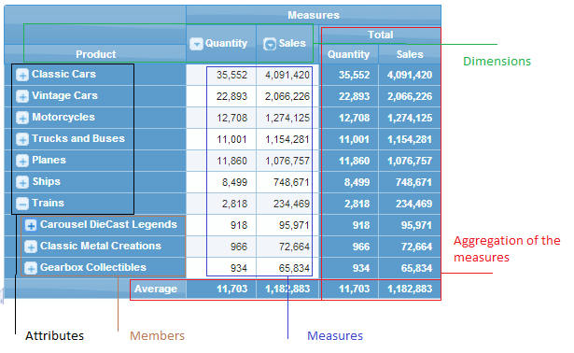
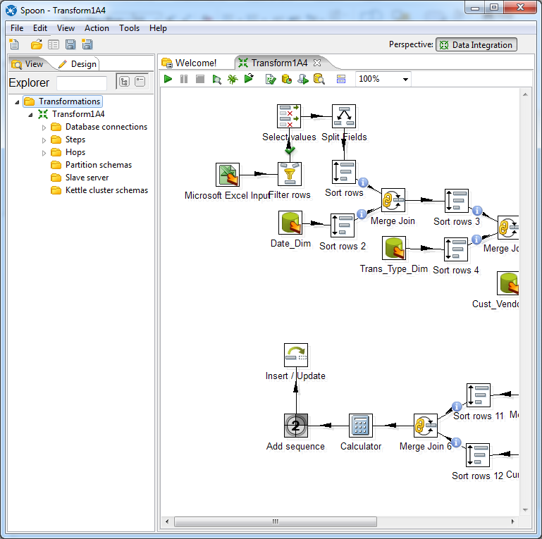
Course Topics
Architectures
Pivot Table Manipulation
Schema Design
Data Integration
Notes:
Course 1: Concepts, Design, and Data Integration
Unit 1:
Motivation and historical background
Basic definitions
Business architectures: balance scope, integration level, risk, business value
Maturity models
Data cube manipulation:
Multidimensional data model
Multidimensional expressions language
Pivot4J practice
Schema Design:
Schema patterns
Summarizability patterns
Enterprise development methodologies
Schema integration practice
Data integration
Refresh and data population processes
Transformation techniques
Integrated development environments
Practice with Pentaho Data Integration

Slide 4
Course Flow
Module 1
Motivation and characteristics
Module 2
Multi-dimensional data model
Module 3
Schema patterns and summarizability problems
Architectures
Project characteristics and maturity model
Pivot table tool practice
Enterprise data warehouse development
Module 4
Data integration process concepts
Architectures and features of data integration tools
Data integration techniques
Schema integration practice
Microsoft MDX language
Employment opportunities
Module 5
Overview of Talend and Pentaho tools
Practice with Pentaho Data Integration
Change data characteristics
Notes:
Module 1
Historical background and importance
Characteristics
Business architectures
Maturity model and project characteristics
Employment opportunities
Module 2
Multi-dimensional data model for business analysis
Microsoft MDX language overview
Pivot table practice using Pivot4J
Module 3
Schema patterns: star schema and variations
Summarizability problems and resolution: mostly missing data issues
Schema integration practice
Enterprise data warehouse development methodologies
Module 4
Data integration processes
Change data characteristics
Data integration techniques for regular expressions and text distance functions
Module 5
Architectures for data integration tools
Common features of data integration tools
Data integration techniques especially regular expressions and distance functions
Data integration practice using Pentaho Data Integration
Assignments in modules 2, 3 and 5
Quizzes at the end of each module

Slide 5
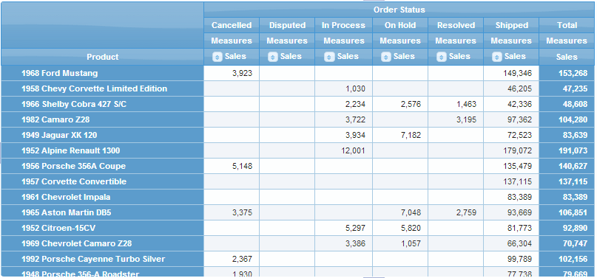
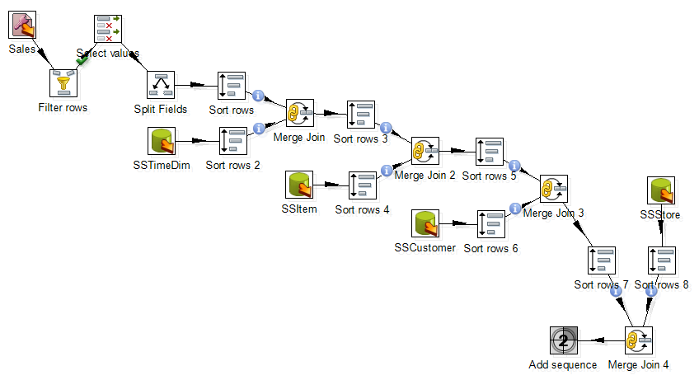
Assignments
Data source 1
Data source n
DW schema
Pivot Table Manipulation
Schema Integration
Data Integration Workflow
Notes:
Pivot table manipulation using Pivot4J
Evaluation using an online quiz
Guided exercise
Graded assignment after completion of guided exercise
Schema integration exercise:
Combine schemas of two data sources
DW schema pattern
Populate sample data
Identify important parts of mapping such as missing values and default values
Peer evaluation
Practice evaluation before assignment
Data integration using Pentaho Data Integration
Connect to Oracle tables
Use data sources (Access and Excel)
Guided practice exercise
Graded assignment using online quiz

Slide 6






Tools
Notes:
Pivot4J (http://www.pivot4j.org)
Pentaho Community Edition (): Pentaho Business Analytics Platform has Pivot4J as a tool
Pivot4J is an open source tool; Free download from source forge
WebPivotTable has a free and subscription edition. WebPivotTable is javascript based so executes inside browser.
Pentaho Data Integration, community edition
Limited usage of Oracle or MySQL for data connection in data integration assignment

Slide 7
Summary
Balance concepts, design, software skills, and management practices
Assignments for schema design, pivot table manipulation, and data integration workflows
Usage of open source tools for pivot table manipulation and data integration workflows
Notes:
Important material for students who seek opportunities in business intelligence
Appeal to both business and CS students
Major skills
Schema design for analyzing data sources and business needs
Data integration process design and implementation
Interesting and important tools to use:
Pentaho Data Integration
Pivot4J
Limited usage of Oracle or MySQL in the data integration assignment

